Slide 1
CSE 440
Artificial Intelligence
Probability & Bayes Net
Dr. Mohammad Mahmudul Alam
Department of Electrical & Computer Engineering (ECE)
North South University (NSU)

Slide 2
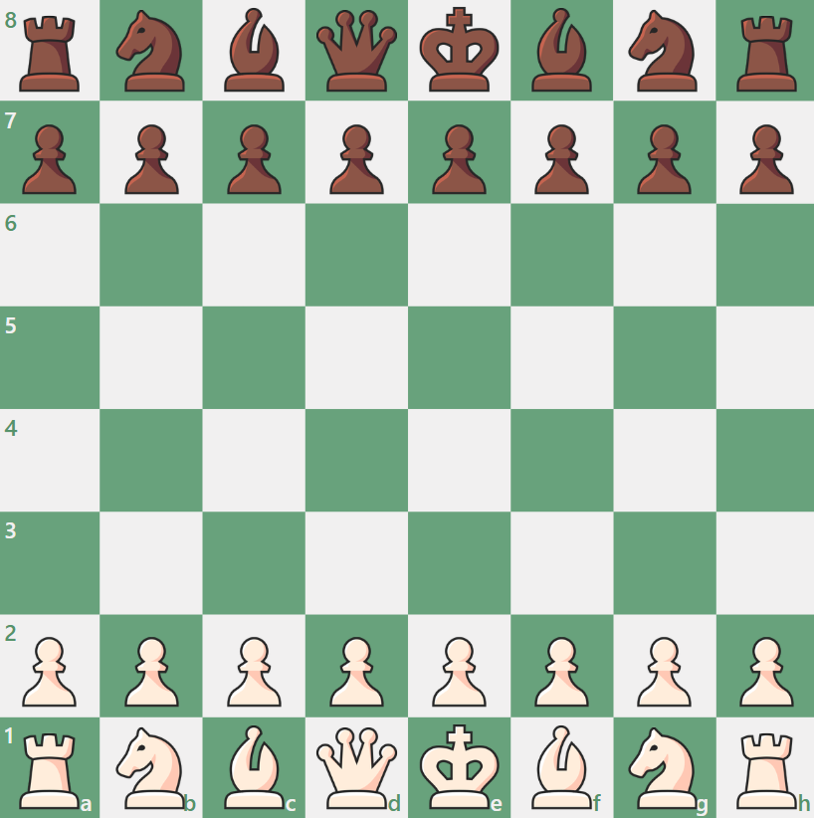
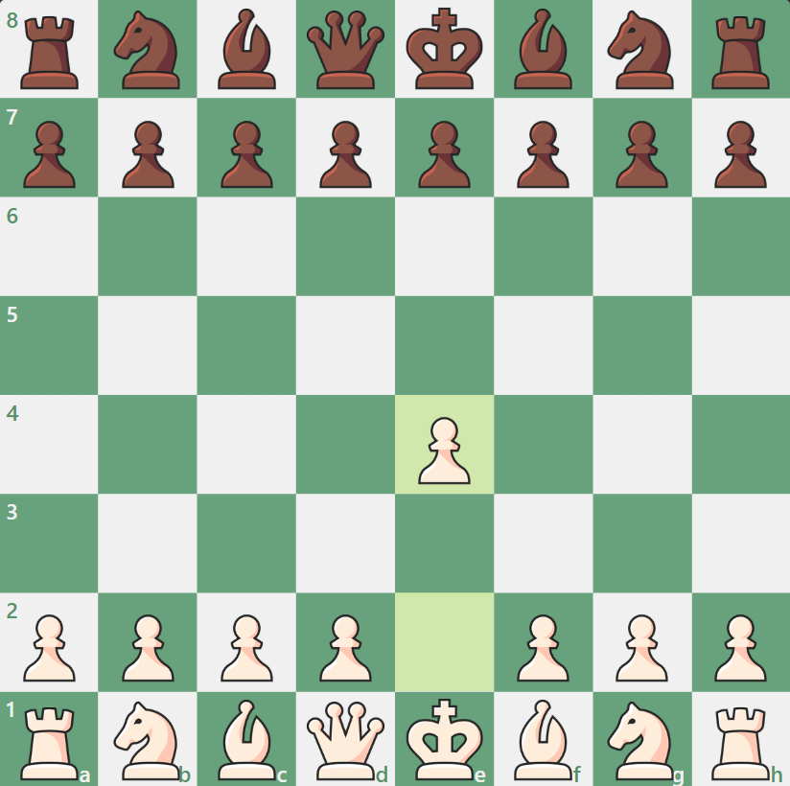
Introduction
All the problem we dealt with so far are deterministic.
However, most of real-world problems are:
Non-deterministic (Stochastic)
Partially Observable

Slide 3
Acting under Uncertainty
Agents in the real world need to handle uncertainty due to partial observability, non-determinism, or adversaries.
An agent may never know for sure what state it is in now or where it will end up after a sequence of actions.
Say we have a rule: if toothache then problem is cavity.
But not all patients have toothaches due to cavities, so we could set up rules like:
if toothache and ¬gum-disease and ¬filling and ... then problem = cavity
This gets complicated. A better method:
if toothache then problem is cavity with 0.8 probability or P(cavity | toothache) = 0.8
The probability of cavity is 0.8 given toothache is observed.

Slide 4
Uncertainty in the World
True uncertainty: rules are probabilistic in nature.
E.g., quantum mechanics, rolling dice, flipping a coin.
Laziness: too hard to determine exception-less rules.
Takes too much work to determine all the relevant factors.
Too hard to use the enormous rules that result.
Theoretical ignorance: don't know all the rules.
Problem domain has no complete, consistent theory (e.g., medical diagnosis).
Practical ignorance: do know all the rules.
Haven't collected all relevant information for a particular case.

Slide 5
Probability Notion
Probability theory serves as a formal means for:
Representing and reasoning with uncertain knowledge.
Modeling degrees of belief in a proposition (event, conclusion, diagnosis, etc.)
Probability is the “language” of uncertainty.
A key modeling tool in modern AI.

Slide 6
Event
A proposition also known as “event” is:
X=x which means variable X takes value x e.g., RoadCurvature = left.
Either true or false in the world.
Agent has a degree of belief in the proposition.

Slide 7
Sample Space
A space of events in which we assign probabilities.
Events can be binary, multi-valued, or continuous.
Events are mutually exclusive.
Examples:
Coin flip: {head, tail}.
Die roll: {1, 2, 3, 4, 5, 6}.
English words: Any word from the dictionary.
High temperature tomorrow: {-100, …, 100}.

Slide 8
Random Variable
A variable X whose domain is a sample space and whose value is (somewhat) uncertain. E.g.,
X = coin flip outcome
X = tomorrow’s high temperature
The user defines random variables to describe the world.
Each variable has mutually exclusive and exhaustive values.
Boolean: domain = <true, false>
E.g., Cavity = true (cavity) or Cavity = false (¬cavity)
Discrete: domain is countable values
Sky domain = <clear, partly_cloudy, overcast>
E.g., Sky = clear (clear) or Sky ≠ clear (¬clear)

Slide 9


Probability
An agent’s uncertainty is represented by:
P(X=x) or simply P(x)
The agent’s degree of belief that variable X takes on value x given no other information related to X
A single probability called an unconditional or prior probability.

Slide 10
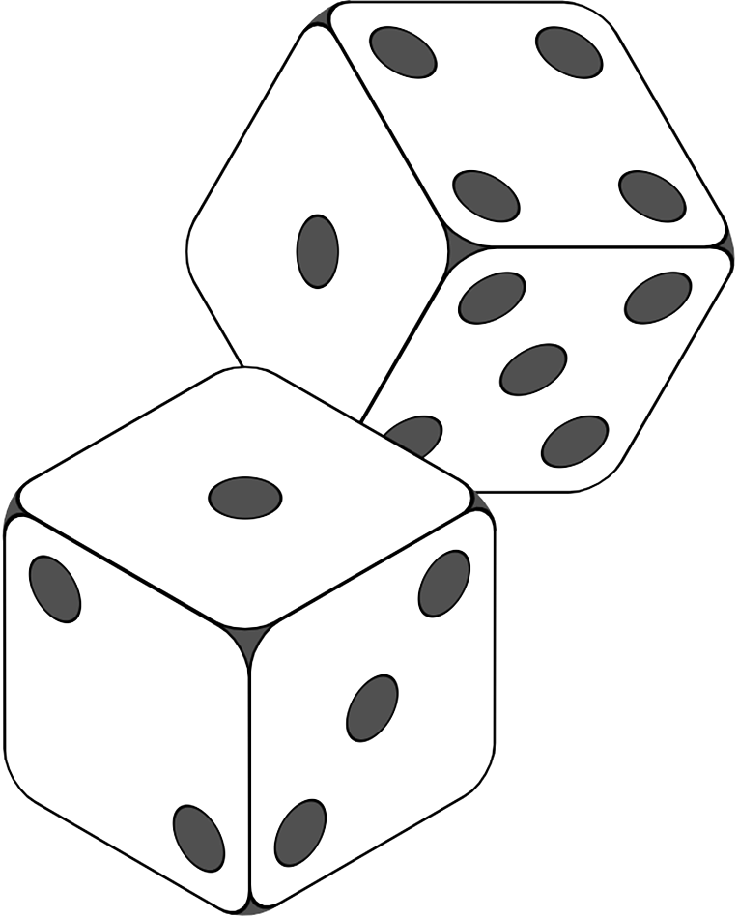
Basic Probability
Each P is a non-negative value in [0, 1]
E.g., P({1,1}) = 1/6 * 1/6 = 1/36
Total probability of the sample space is 1
P({1,1}) + P({1,2}) + P({1,3}) + … + P({6,6}) = 1
For mutually exclusive events, the probability for at least one of them is the sum of their individual probabilities
P(sunny) ∨ P(cloudy) = P(sunny) + P(cloudy)

Slide 11
Source of Probability
Frequentists:
Probabilities come from data, if 10 of 100 people tested have a cavity, P(cavity) = 0.1
Probability means the fraction that would be observed in the limit of infinitely many samples.
Objectivists:
Probabilities are real and reflect objects' tendencies.
A coin has a 0.5 propensity to land heads.
Subjectivists:
Probabilities characterize an agent's belief.
Expert-assessed, but no external physical significance.

Slide 12
Example: Probability Table
Sunny | Cloudy | Rainy
200/365 | 100/365 | 65/365
P(Weather = sunny) = P(sunny) = 200/365
P(Weather) =〈 200/365, 100/365, 65/365 〉= 1
We’ll obtain the probabilities by counting frequencies from observed available data.

Slide 13


Axioms of Probability
All rules of probability theory is based on 3 axioms:
All probabilities are between 0 and 1.
0 ≤ P(A) ≤ 1
Valid propositions (tautologies) have probability 1, and unsatisfiable propositions have probability 0.
P(true) = 1
P(false) = 0
The probability of a disjunction is:
P(A ⋁ B) = P(A) + P(B) – P(A ⋀ B)
Note: Here P(A) means P(A=a) for some value “a” and P(A⋁B) means P(A=a ⋁ B=b).

Slide 14
Compound Probability
The probability of multiple events occurring, which can involve either independent or dependent events.
Compound probability includes joint probability P(A⋀B), conditional probability P(A|B), and union probability P(A⋁B).
Joint probability of two independent events A and B:
P(A ∧ B) = P(A) * P(B)
Union probability of two independent events A and B = P(A ⋁ B) = P(A) + P(B) - P(A ⋀ B) = P(A) + P(B) - (P(A) * P(B))

Slide 15
Joint Probability
 |  | Weather
Temp |  | Sunny | Cloudy | Rainy
 | Hot | 150 | 40 | 5
 | Cold | 50 | 60 | 60
The probability of two (or more) events happening together at the same time.
The joint probability P(A=a, B=b) is shorthand for P(A=a ⋀ B=b), i.e., the probability of both A = a and B = b happening at the same time.
P(Temp=hot, Weather=rainy) = P(hot, rainy) = 5/365 = 0.014

Slide 16
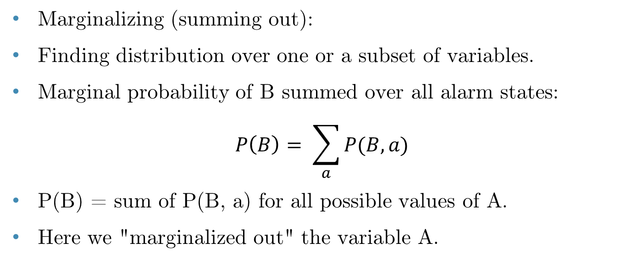
Marginal Probability
 | Alarm | ¬Alarm
Burglary | 0.09 | 0.01
¬Burglary | 0.10 | 0.80
Marginalizing (summing out):
Finding distribution over one or a subset of variables.
Marginal probability of B summed over all alarm states:
$$P\left(B\right)= \sum_{a}{P(B, a)}$$
P(B) = sum of P(B, a) for all possible values of A.
Here we "marginalized out" the variable A.

Slide 17
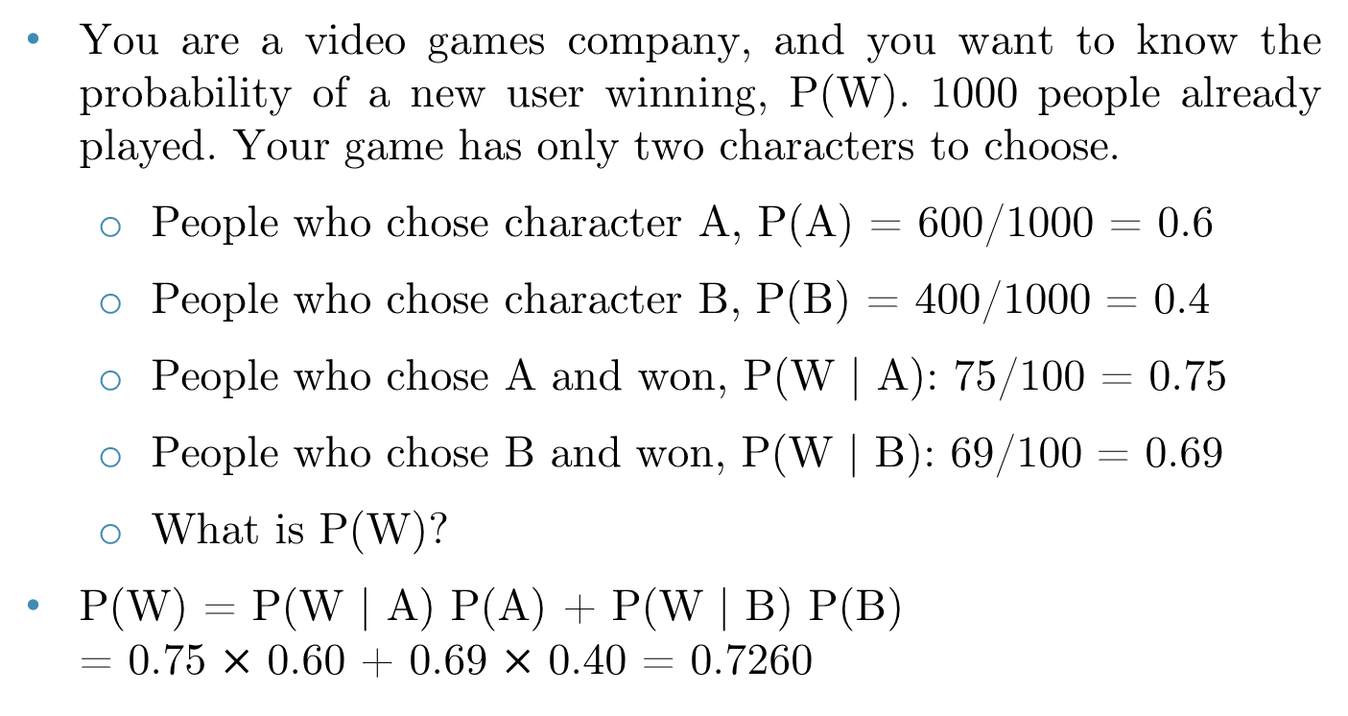


Marginal Probability: Exercise
You are a video games company, and you want to know the probability of a new user winning, P(W). 1000 people already played. Your game has only two characters to choose.
People who chose character A, P(A) = 600/1000 = 0.6
People who chose character B, P(B) = 400/1000 = 0.4
People who chose A and won, P(W | A): 75/100 = 0.75
People who chose B and won, P(W | B): 69/100 = 0.69
What is P(W)?
P(W) = P(W | A) P(A) + P(W | B) P(B) = 0.75 $×$ 0.60 + 0.69 $×$ 0.40 = 0.7260

Slide 18
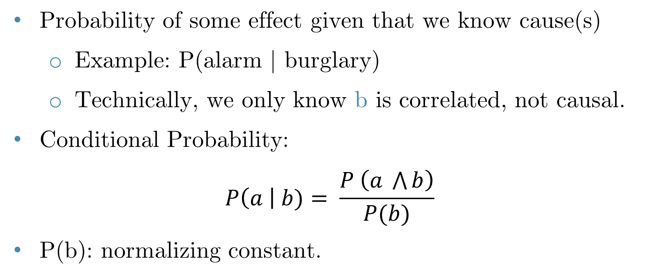
Conditional Probability
Probability of some effect given that we know cause(s)
Example: P(alarm | burglary)
Technically, we only know b is correlated, not causal.
Conditional Probability:
$$P\left(a \right| b)= \frac{P \left(a \bigwedge{b}\right)}{P(b)}$$
P(b): normalizing constant.

Slide 19
Conditional Probability
Conditional probabilities behave exactly like standard probabilities; for example:
0 ≤ P(a | e) ≤ 1
Conditional probabilities are between 0 and 1 inclusive:
P(a1 | e) + P(a2 | e) + ... + P(ak | e) = 1
Conditional probabilities sum to 1 where a1, …, ak are all values in the domain of random variable A.
P(¬a | e) = 1 − P(a | e)

Slide 20
Chain Rule
From the definition of conditional probability, we have:
P(A, B) = P(B) * P(A | B) = P(A | B) * P(B)
It also works the other way around:
P(A, B) = P(A) * P(B | A) = P(B | A) P(A)
In general,
P(A1, A2, …, An) = P(A1) * P(A2 | A1) * P(A3| A1, A2) * …
* P(An | A1, A2, …, An-1)

Slide 21
Exercise
 | Alarm | ¬Alarm
Burglary | 0.09 | 0.01
¬Burglary | 0.10 | 0.80
Marginalizing: P(A) = 0.09 + 0.10 = 0.19
Product Rule: P(A ⋀ B) = 0.09
Conditional Probability:
P(A | B) = P(A ⋀ B) / P(B) = 0.09 / (0.09 + 0.01) = 0.9
P(B | A) = P(A ⋀ B) / P(A) = 0.09 / (0.09 + 0.10) = 0.47

Slide 22
Exercise
What is the prior probability of smart?
What is the prior probability of study?
What is the conditional probability of prepared, given study and smart?
P(smart ⋀ study ⋀ prep) | smart |  | ¬smart
 | study | ¬study | study | ¬study
prepared | 0.432 | 0.160 | 0.084 | 0.008
¬prepared | 0.048 | 0.160 | 0.036 | 0.072

Slide 23
Exercise
What is the prior probability of smart?
What is the prior probability of study?
What is the conditional probability of prepared, given study and smart?
P(smart ⋀ study ⋀ prep) | smart |  | ¬smart
 | study | ¬study | study | ¬study
prepared | 0.432 | 0.160 | 0.084 | 0.008
¬prepared | 0.048 | 0.160 | 0.036 | 0.072
P(smart) = 0.432 + 0.048 + 0.160 + 0.160 = 0.8

Slide 24
Exercise
What is the prior probability of smart?
What is the prior probability of study?
What is the conditional probability of prepared, given study and smart?
P(smart ⋀ study ⋀ prep) | smart |  | ¬smart
 | study | ¬study | study | ¬study
prepared | 0.432 | 0.160 | 0.084 | 0.008
¬prepared | 0.048 | 0.160 | 0.036 | 0.072
P(study) = 0.432 + 0.048 + 0.084 + 0.036 = 0.6

Slide 25
Exercise
What is the prior probability of smart?
What is the prior probability of study?
What is the conditional probability of prepared, given study and smart?
P(smart ⋀ study ⋀ prep) | smart |  | ¬smart
 | study | ¬study | study | ¬study
prepared | 0.432 | 0.160 | 0.084 | 0.008
¬prepared | 0.048 | 0.160 | 0.036 | 0.072
P(prep | study, smart) = $\frac{P(prep, study, smart)}{P(study, smart)}$ = $\frac{0.432}{0.432+0.048}$ = 0.9

Slide 26
Independence ⫫
P(A)
P(A ⋀ B)
P(B)
P(A ⋀ B) = P(A) * P(B)
Independent: Two sets of propositions that do not affect each others' probabilities.
A
B
Q: Are A & B independent?

Slide 27
Conditional Independence
Absolute independence: A ⫫ B, if:
P(A ⋀ B) = P(A) * P(B)
Equivalently, P(A) = P(A | B) and P(B) = P(B | A)
A and B are conditionally independent given C if:
P(A ⋀ B | C) = P(A | C) P(B | C)
This lets us decompose the joint distribution:
P(A ⋀ B ⋀ C) = P(A | C) P(B | C) P(C)

Slide 28
Bayes’ Rule
Bayes’ rule forms the foundation of probabilistic reasoning based on a prior model of the world.
When new evidence is introduced, Bayes’ rule determines how this evidence updates our understanding.
It reduces uncertainty by adjusting beliefs based on new information.
Derive the probability of some event, given another event.
Assumes attributes are independent (Naïve assumption).
Bayes’ rule, derived from the product rule, forms the basis of modern machine learning.

Slide 29
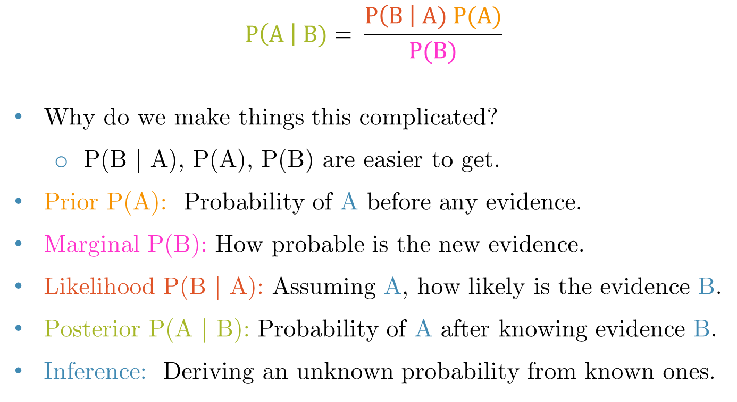
Bayes’ Rule
$$P\left(A \right| B)= \frac{P\left(B \right| A) P(A)}{P(B)}$$
Why do we make things this complicated?
P(B | A), P(A), P(B) are easier to get.
Prior P(A): Probability of A before any evidence.
Marginal P(B): How probable is the new evidence.
Likelihood P(B | A): Assuming A, how likely is the evidence B.
Posterior P(A | B): Probability of A after knowing evidence B.
Inference: Deriving an unknown probability from known ones.

Slide 30

Bayes’ Rule: Exercise
Historically Bayes’ rule is quite useful for medical diagnosis.

Slide 31
Bayes’ Rule: Exercise 01
Problem: A doctor performs a test that has 99% reliability, i.e., 99% of people who are sick test positive, and 99% of people who are healthy test negative. The doctor estimates that 1% of the population is sick.
Query: A patient tests positive. What is the chance that the patient is sick?

Slide 32
Bayes’ Rule: Exercise 01
Problem: A doctor performs a test that has 99% reliability, i.e., 99% of people who are sick test positive, and 99% of people who are healthy test negative. The doctor estimates that 1% of the population is sick.
P(TP | S) = 0.99, P(¬TP | ¬S) = 0.99, P(S) = 0.01
P(S | TP) = P(TP | S) * P(S) / P(TP)
P(TP) = P(TP | S) P(S) + P(TP | ¬S) P(¬S)
= 0.99 * 0.01 + (1 – 0.99) [1 - P(¬TP | ¬S)] * (1 - 0.01)
= 0.0198
P(S | TP) = 0.99 * 0.01 / 0.0198 = 0.50 = 50%

Slide 33
Bayes’ Rule: Exercise 02
Problem: Your patient comes in with a stiff neck. Suppose we know that Stiff neck is a symptom in 50% of meningitis cases. Meningitis (m) occurs in 1/50,000 patients and Stiff neck (s) occurs in 1/20 patients.
Query: Is it meningitis?

Slide 34
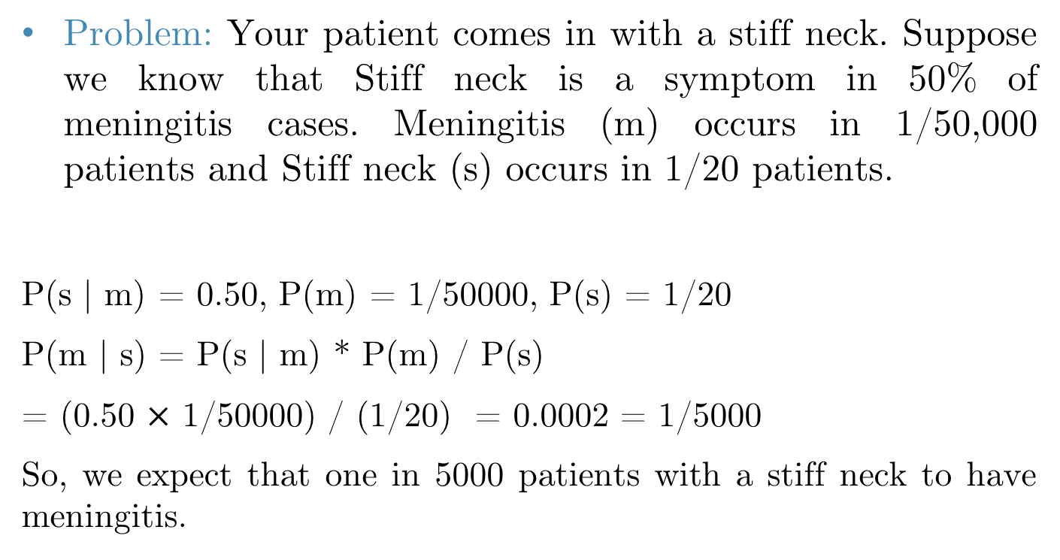
Bayes’ Rule: Exercise 02
Problem: Your patient comes in with a stiff neck. Suppose we know that Stiff neck is a symptom in 50% of meningitis cases. Meningitis (m) occurs in 1/50,000 patients and Stiff neck (s) occurs in 1/20 patients.
P(s | m) = 0.50, P(m) = 1/50000, P(s) = 1/20
P(m | s) = P(s | m) * P(m) / P(s)
= (0.50 $×$ 1/50000) / (1/20) = 0.0002 = 1/5000
So, we expect that one in 5000 patients with a stiff neck to have meningitis.

Slide 35
Summary of Probability Rules
Conditional probability: P(A|B) = P(A ⋀ B) / P(B)
Product rule: P(A, B) = P(A ⋀ B) = P(A | B) * P(B)
Chain rule: P(A,B,C,D) = P(A|B,C,D) * P(B|C,D) * P(C|D) * P(D)
Conditional chain rule: P(A,B|C) = P(A|B,C) P(B|C)
Bayes’ rule: P(A|B) = P(B|A) * P(A) / P(B)
Conditional Bayes’ rule: P(A|B,C) = P(B|A,C) * P(A|C) / P(B|C)
Addition / Conditioning rule:
P(A) = P(A,B) + P(A,¬B)
P(A) = P(A|B) * P(B) + P(A|¬B) * P(¬B)

Slide 36
Common Mistake
P(A) = 0.3, so P(¬A) = 1 – P(A) = 0.7
P(A | B) = 0.4, so P(¬A|B) = 1 – P(A | B) = 0.6, because P(A|B) + P(¬A|B) = 1
BUT,
P(A|¬B) ≠ 0.6
P(A|B) + P(A|¬B) ≠ 1

Slide 37
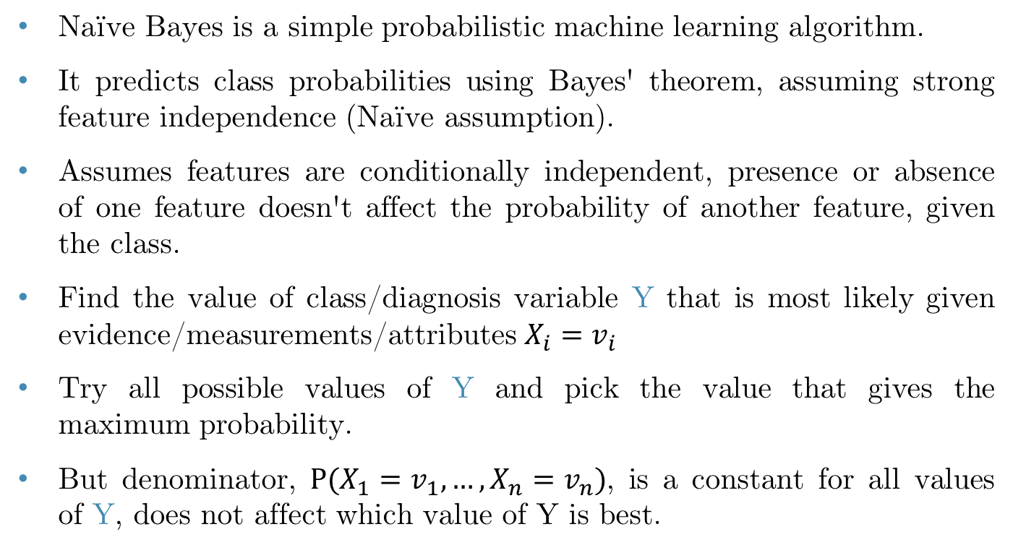
Naïve Bayes Algorithm
Naïve Bayes is a simple probabilistic machine learning algorithm.
It predicts class probabilities using Bayes' theorem, assuming strong feature independence (Naïve assumption).
Assumes features are conditionally independent, presence or absence of one feature doesn't affect the probability of another feature, given the class.
Find the value of class/diagnosis variable Y that is most likely given evidence/measurements/attributes $X_{i}=v_{i}$
Try all possible values of Y and pick the value that gives the maximum probability.
But denominator, $P(X_{1}=v_{1}, …, X_{n}=v_{n})$, is a constant for all values of Y, does not affect which value of Y is best.

Slide 38
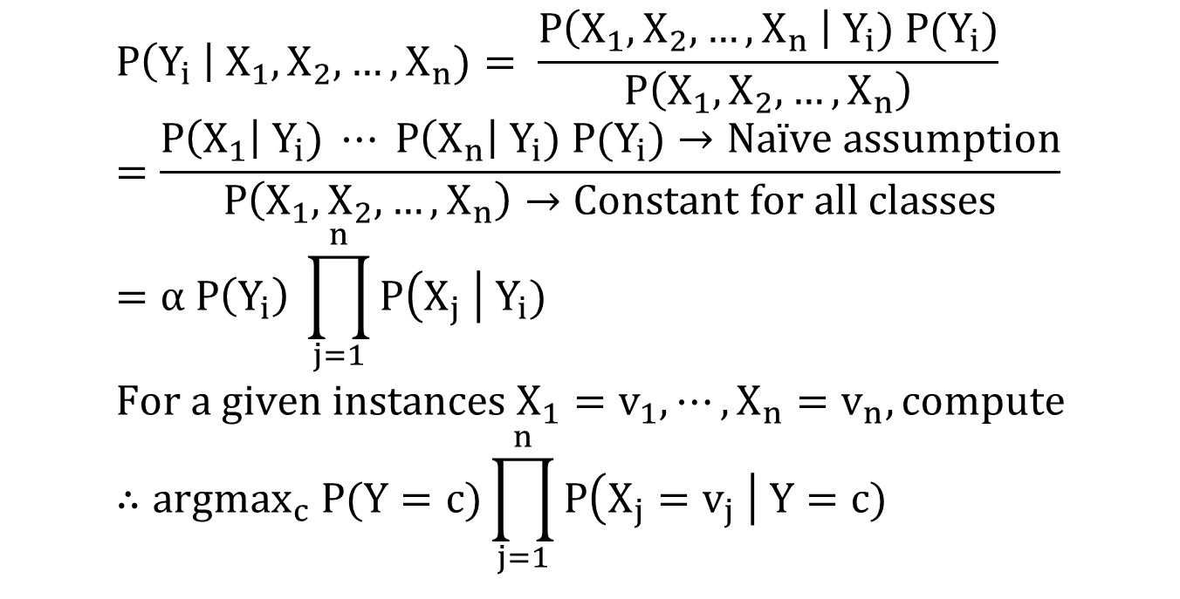
Naïve Bayes Algorithm
$$P\left(Y_{i} \right| X_{1},X_{2},…, X_{n})= \frac{P\left(X_{1}, X_{2},…, X_{n} \right| Y_{i}) P(Y_{i})}{P\left(X_{1}, X_{2},…, X_{n}\right)} \\ =\frac{P\left(X_{1}\right| Y_{i}) ⋯ P\left(X_{n}\right| Y_{i}) P(Y_{i})→Naïve assumption}{P\left(X_{1}, X_{2},…, X_{n}\right)→Constant for all classes} \\ =α P\left(Y_{i}\right) \prod_{j=1}^{n}{P\left(X_{j} \right| Y_{i})} \\ For a given instances X_{1}=v_{1}, ⋯, X_{n}=v_{n}, compute \\ ∴argmax_{c} P(Y=c)\prod_{j=1}^{n}{P\left(X_{j}=v_{j} \right| Y=c)}$$

Slide 39
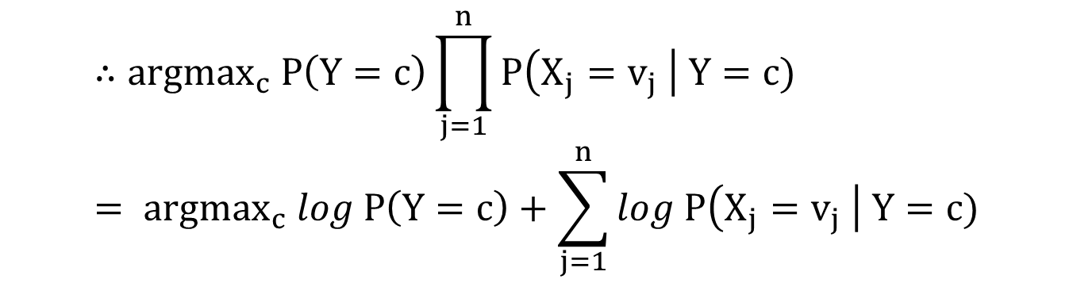
Naïve Bayes Algorithm
Conditional probabilities can be very, very small, so instead use logarithms to avoid underflow:
$$∴argmax_{c} P\left(Y=c\right)\prod_{j=1}^{n}{P\left(X_{j}=v_{j} \right| Y=c)} \\ = argmax_{c} log P\left(Y=c\right)+\sum_{j=1}^{n}{log P\left(X_{j}=v_{j} \right| Y=c)}$$

Slide 40
Naïve Bayes Classifier
ID | Weather | Temperature | Humidity | Class (Play)
1 | Sunny | Hot | High | No
2 | Sunny | Hot | Normal | No
3 | Overcast | Hot | High | Yes
4 | Rainy | Mild | High | Yes
5 | Rainy | Cool | Normal | Yes
6 | Rainy | Cool | Normal | No
7 | Overcast | Cool | Normal | Yes
8 | Sunny | Mild | High | No
9 | Sunny | Cool | Normal | Yes
10 | Rainy | Mild | Normal | Yes
11 | Sunny | Mild | Normal | Yes
12 | Overcast | Mild | High | Yes
13 | Overcast | Hot | Normal | Yes
14 | Rainy | Mild | High | No

Slide 41
Naïve Bayes Classifier: Training
Compute Priors:
Count occurrences of each class: P(Yes) = 9/14, P(No) = 5/14
ID | Weather | Temperature | Humidity | Class (Play)
1 | Sunny | Hot | High | No
2 | Sunny | Hot | Normal | No
3 | Overcast | Hot | High | Yes
4 | Rainy | Mild | High | Yes
5 | Rainy | Cool | Normal | Yes
6 | Rainy | Cool | Normal | No
7 | Overcast | Cool | Normal | Yes
8 | Sunny | Mild | High | No
9 | Sunny | Cool | Normal | Yes
10 | Rainy | Mild | Normal | Yes
11 | Sunny | Mild | Normal | Yes
12 | Overcast | Mild | High | Yes
13 | Overcast | Hot | Normal | Yes
14 | Rainy | Mild | High | No

Slide 42
Naïve Bayes Classifier: Training
Compute Likelihood:
For each feature given a class, compute conditional probabilities:
Weather
P(Sunny | Yes) = 2/9, P(Sunny | No) = 3/5
P(Overcast | Yes) = 4/9, P(Overcast | No) = 0/5
P(Rainy | Yes) = 3/9, P(Rainy | No) = 2/5
Temperature:
P(Hot | Yes) = 2/9, P(Hot | No) = 2/5
P(Mild | yes) = 4/9, P(Mild | no) = 2/5
P(Cool | Yes) = 3/9, P(Cool | No) = 1/5
Humidity
P(High | Yes) = 3/9, P(High | No) = 3/5
P(Normal | Yes) = 6/9, P(Normal | No) = 2/5

Slide 43
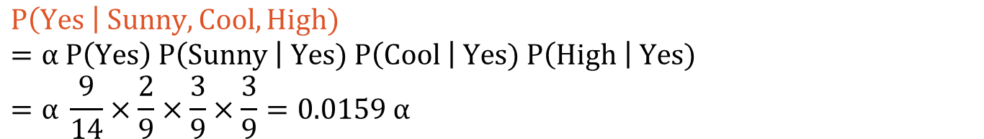
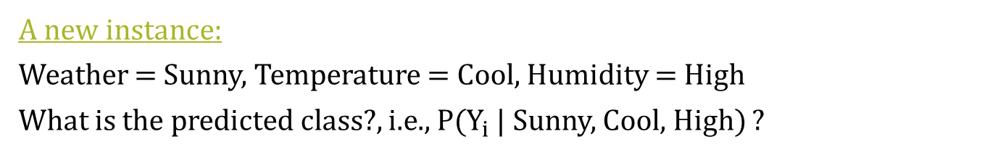
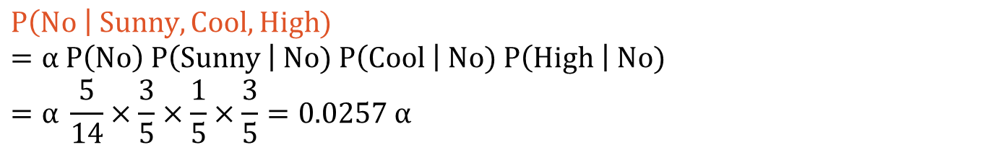
Naïve Bayes Classifier: Inference
A new instance:
Weather = Sunny, Temperature = Cool, Humidity = High
What is the predicted class?, i.e., P($Y_{i}$ | Sunny, Cool, High) ?
$$P\left(Yes \right| Sunny, Cool, High)=α P\left(Yes\right) P\left(Sunny \right| Yes) P\left(Cool \right| Yes) P\left(High \right| Yes) \\ =α \frac{9}{14}×\frac{2}{9}×\frac{3}{9}×\frac{3}{9}=0.0159 α$$
$$P\left(No \right| Sunny, Cool, High) \\ =α P\left(No\right) P\left(Sunny \right| No) P\left(Cool \right| No) P\left(High \right| No) \\ =α \frac{5}{14}×\frac{3}{5}×\frac{1}{5}×\frac{3}{5}=0.0257 α$$
$$Since, α is a positive constant, we can say P\left(No\right)> P\left(Yes\right),$$
$$Therefore, the classifier predicts \text{"}\text{No}\text{"}.$$

Slide 44
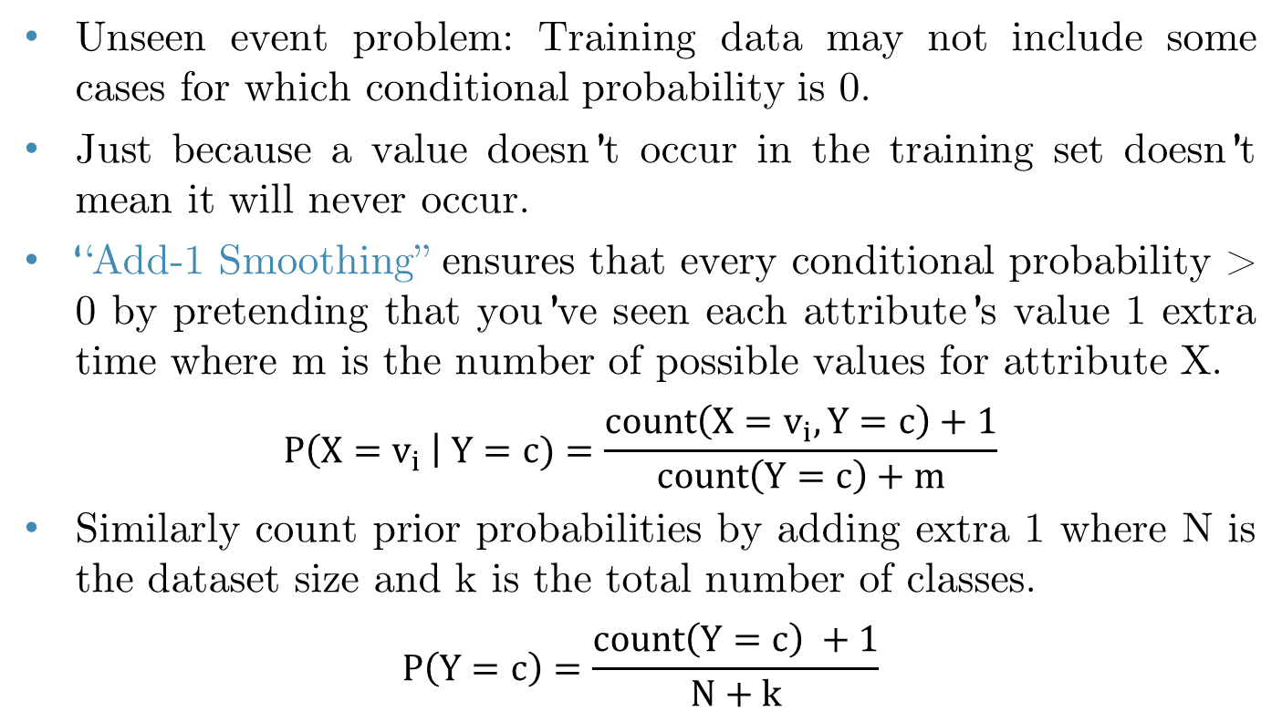
Naïve Bayes Classifier: Smoothing
Unseen event problem: Training data may not include some cases for which conditional probability is 0.
Just because a value doesn’t occur in the training set doesn’t mean it will never occur.
“Add-1 Smoothing” ensures that every conditional probability > 0 by pretending that you’ve seen each attribute’s value 1 extra time where m is the number of possible values for attribute X.
$$P\left(X=v_{i} \right| Y=c)=\frac{count\left(X=v_{i}, Y=c\right)+1}{count\left(Y=c\right)+m}$$
Similarly count prior probabilities by adding extra 1 where N is the dataset size and k is the total number of classes.
$$P\left(Y=c\right)=\frac{count\left(Y=c\right) +1}{N+k}$$

Slide 45
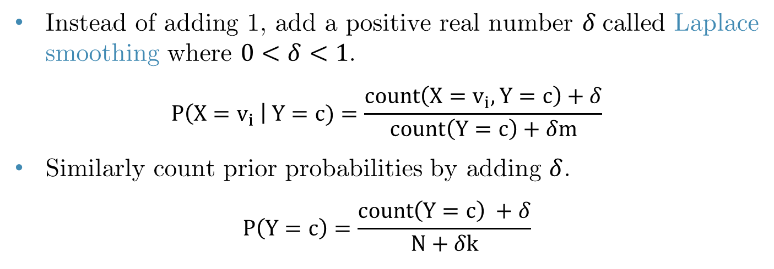
Laplace Smoothing
Instead of adding 1, add a positive real number $δ$called Laplace smoothing where $0<δ<1$.
$$P\left(X=v_{i} \right| Y=c)=\frac{count\left(X=v_{i}, Y=c\right)+δ}{count\left(Y=c\right)+δm}$$
Similarly count prior probabilities by adding $δ$.
$$P\left(Y=c\right)=\frac{count\left(Y=c\right) +δ}{N+δk}$$

Slide 46
Bayesian Network (Bayes’ Net)
Naïve Bayes assumes all features are conditionally independent given the class label.
It has a simple structure with the class variable as the parent and features as independent children.
Bayesian Network (Bayes’ Net) is a generalized version of Naïve Bayes without the independence assumption.
Bayes’ Net uses a Directed Acyclic Graph (DAG) to represent dependencies among variables.
A more flexible graph-based representation where nodes are variables, and edges represent probabilistic dependencies.

Slide 47
Bayesian Network (Bayes’ Net)
Bayes’ Net used in expert systems, medical diagnosis, fraud detection, and decision-making applications.
It is more expressive, models dependencies explicitly, handles missing data well.
However, it is computationally more expensive, requires expert knowledge or large datasets to define dependencies correctly.
Bayes’ Net, also referred to as Belief Net, and Bayesian Belief Network (BBN) are all synonyms for Bayesian Networks.
Naïve Bayes is a restricted form of a Bayesian Network that assumes strict feature independence given the class.

Slide 48
Bayesian Network (Bayes’ Net)
Nodes: Random variables (with domains)
Random variables can be dependent, but conditionally independent.
Arcs: interactions between nodes.
Indicate “direct influence” between
Encode conditional independence:
P(J, M | A) = P(J | A) * P(M | A)
A
J
M

Slide 49
Bayesian Network (Bayes’ Net)
Diagnostic
variables
Flu
Allergy
Sinus
Evidence variables
Runny
Nose
Headache

Slide 50
Creating Bayes’ Net
Let’s say we have 5 random variables:
B: there’s burglary in your house.
E: there’s an earthquake.
A: your alarm sounds.
J: your neighbor John calls you.
M: your other neighbor Mary calls you.
B, E are independent.
J is directly influenced by only A (i.e., J is conditionally independent of B, E, M, given A)
M is directly influenced by only A (i.e., M is conditionally independent of B, E, J, given A)

Slide 51
Creating Bayes’ Net
Step 1: Add variables.
Choose the variables you want to include in the Bayes Net.
B
E
B: there’s burglary in your house.
E: there’s an earthquake.
A: your alarm sounds.
J: your neighbor John calls you.
M: your other neighbor Mary calls you.
A
J
M

Slide 52
Creating Bayes’ Net
Step 2: Add directed edges
The graph must be acyclic
If node X is given parents Q1, …, Qm, you are saying that any variable that’s not a descendant of X is conditionally independent of X given Q1, …, Qm.
B
E
B: there’s burglary in your house.
E: there’s an earthquake.
A: your alarm sounds.
J: your neighbor John calls you.
M: your other neighbor Mary calls you.
A
J
M

Slide 53
Creating Bayes’ Net
Step 3: Add Conditional Probability Tables (CPT).
The table at node X must list P(X | Parent values) for all combinations of parent values.
E.g., you must specify P(J|A) and P(J|¬A) since they don’t have to sum to 1!
P(B) = 0.001
P(E) = 0.002
B
E
B: there’s burglary in your house.
E: there’s an earthquake.
A: your alarm sounds.
J: your neighbor John calls you.
M: your other neighbor Mary calls you.
P(A | B, E) = 0.95
P(A | B, ¬E) = 0.94
P(A | ¬B, E) = 0.29
P(A | ¬B, ¬E) = 0.001
A
J
M
P(J|A) = 0.9
P(J|¬A) = 0.05
P(M|A) = 0.7
P(M|¬A) = 0.01

Slide 54
Creating Bayes’ Net
Choose a set of relevant variables
Choose an ordering of them, call them X1, …, XN
for i = 1 to N:
Add node Xi to the graph.
Set parents(Xi) to be the minimal subset of {X1…Xi-1}, such that xi is conditionally independent of all other members of {X1…Xi-1} given parents (Xi).
Define the CPTs for P(Xi | assignments of parents (Xi))
Where do you get these CPT numbers?
Ask domain experts.
Learn from data.

Slide 55
Variable Dependencies
A
B
Directed arc from one variable to another variable.
Is A guaranteed to be independent of B?
No. Information can be transmitted over 1 arc (in either direction).

Slide 56
Causal Chain
A
B
C
This local configuration is called a “causal chain”.
Is A guaranteed to be independent of C?
No. Information can be transmitted between A and C through B if B is not observed.
Notes:
Bayes net contains B → A → M
Not knowing Alarm means that my knowing that a Burglary has occurred increases my belief that Mary calls, and similarly, knowing that Mary Calls increases my belief that there has been a Burglary.
From conditional independence prop of BN, we know P(A,B,C) = P(C|B)P(B|A)P(A)
One example that shows A not independent of C: Let P(B|A) = 1 if B=A; 0 otherwise, and P(C|B) = 1 if C=B; 0 otherwise
Then P(C|A) = 1 if C=A; 0 otherwise. Hence A and C are not independent in this example

Slide 57
Causal Chain
A
B
C
This local configuration is called a “causal chain”.
Is A independent of C given B?
Yes. Once B is observed, information cannot be transmitted between A and C through B. B “blocks” the information path. C is conditionally independent of A given B.
Notes:
Knowing that the Alarm went off means that also knowing that a Burglary has taken place will not increase my belief that Mary Calls

Slide 58
Common Cause
A
B
C
This configuration is called “common cause”.
Is it guaranteed that B and C are independent?
No. Information can be transmitted through A to the children of A if A is not observed.
Is it guaranteed that B and C are independent given A?
Yes. Observing the cause, A, blocks the influence between effects B and C. B is conditionally independent of C given A.
Notes:
Proof that B and C are not independent by giving a counterexample.
Proof that B and C are independent given A: P(C|A,B) = P(A,B,C)/P(A,B) = P(C,B,A)/P(B,A) = P(C|B,A)P(B|A)P(A)/P(B|A)P(A) = P(C|A)

Slide 59
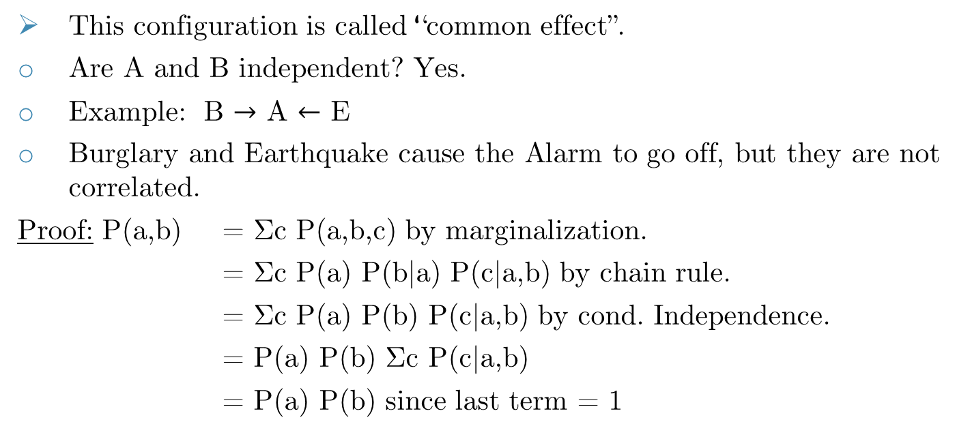
Common Effect
A
B
C
This configuration is called “common effect”.
Are A and B independent? Yes.
Example: B $→$ A $←$ E
Burglary and Earthquake cause the Alarm to go off, but they are not correlated.
Proof: P(a,b) = Σc P(a,b,c) by marginalization.
= Σc P(a) P(b|a) P(c|a,b) by chain rule.
= Σc P(a) P(b) P(c|a,b) by cond. Independence.
= P(a) P(b) Σc P(c|a,b)
= P(a) P(b) since last term = 1
Notes:
Not quite a proof because A and B may have parents. But illustrates general idea.
First step follows from marginalization. Second step follows from product formula.
3rd step follows since P(a), P(b) do not depend on c. Last step follows P(c|a,b) adds up to 1 over possible c values.

Slide 60
Common Effect
A
B
C
This configuration is called “common effect”.
Are A and B independent given C?
No. Information can be transmitted through C among the parents of C if C is observed.
Notes:
If I already know that the Alarm went off, my further knowing that there has been an Earthquake decreases my belief that there has been a Burglary. Called “explaining away.”

Slide 61
Conditional Independence
Age
Gender
Smoking
Cancer is conditionally independent of Age and Gender given Smoking.
Cancer

Slide 62
Conditional Independence
Cancer
Serum Calcium is conditionally independent of Lung Tumor, given Cancer.
Serum
Calcium
Lung
Tumor

Slide 63
Bayes’ Net: Application
Medical diagnosis systems
Manufacturing system diagnosis
Computer systems diagnosis
Network systems diagnosis
Helpdesk troubleshooting
Information retrieval
Customer modeling

Slide 64
Bayes’ Net: Exercise
P(S) = 0.3
S
M
P(M) = 0.6
L
R
P(L|M,S) = 0.05
P(L|M,¬S) = 0.1
P(L|¬M,S) = 0.1
P(L|¬M, ¬S) = 0.2
P(R|M) = 0.3
P(R|¬M) = 0.6
T
P(T|L) = 0.3
P(T|¬L) = 0.8
Computing a joint entry from a Bayes’ Net:
What is P(S, ¬M, L, ¬R, T)?

Slide 65
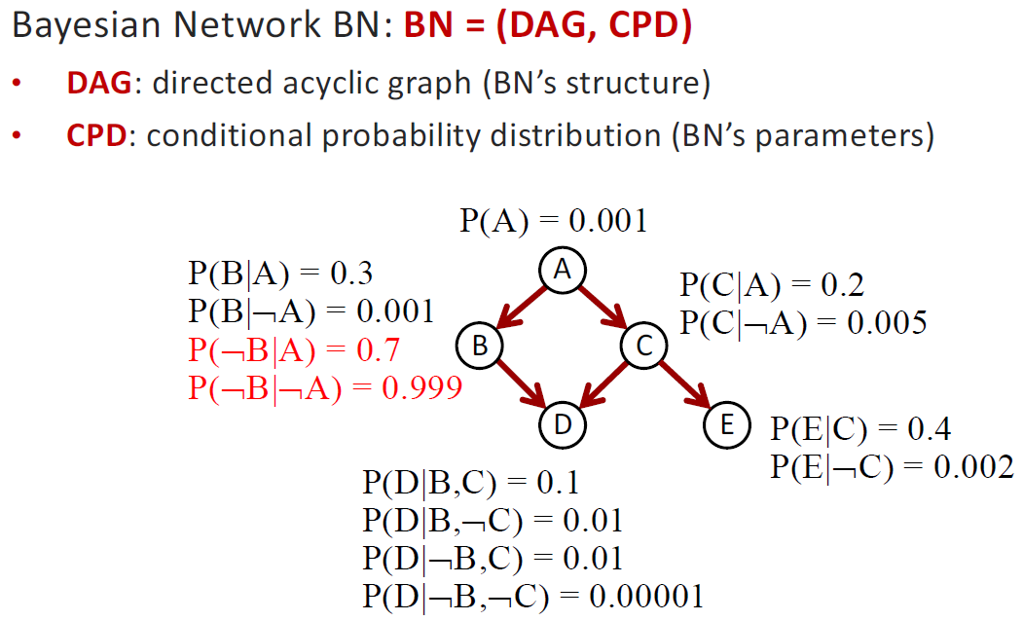
Bayes’ Net: Exercise
P(A, B, C, D, E) = P(A) P(B | A) P(C | A) P(D | B, C) P(E | C)

Slide 66
Bayes’ Net Inference
Instead of computing the joint, suppose we just want the probability for one variable.
We will explore two exact methods of computation:
Enumeration
Variable Elimination

Slide 67
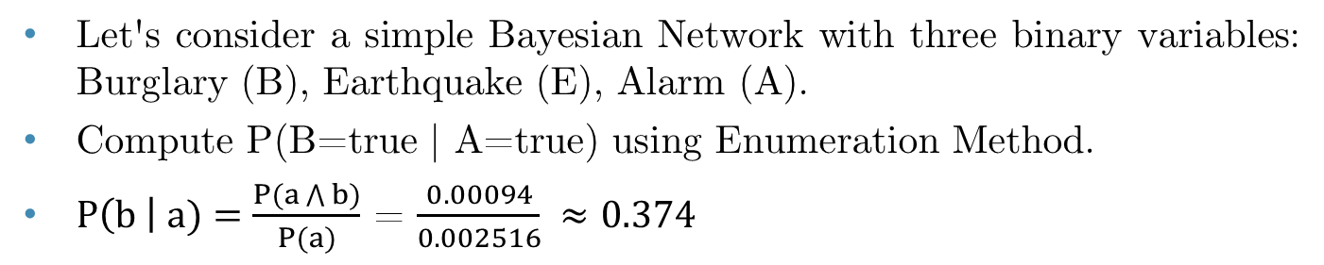
Enumeration
P(B) = 0.001
B
E
P(E) = 0.002
A
P(A|B,E) = 0.95
P(A|B,¬E) = 0.94
P(A|¬B,E) = 0.29
P(A|¬B,¬E) = 0.001
Let's consider a simple Bayesian Network with three binary variables: Burglary (B), Earthquake (E), Alarm (A).
Compute P(B=true | A=true) using Enumeration Method.
$P\left(b \right| a)=\frac{P(a\bigwedge{b})}{P(a)}$ = $\frac{0.00094}{0.002516} ≈0.374$

Slide 68
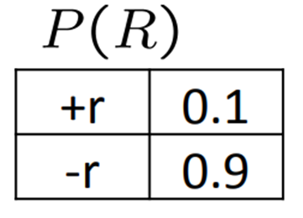
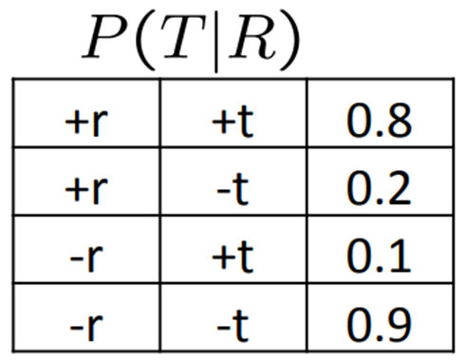
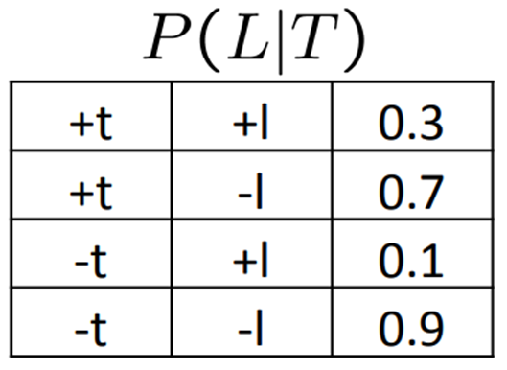
Variable Elimination
R
T
L
Random Variables:
R: Raining
T: Traffic
L: Late for class!
Compute P(L) using variable elimination method.
P(L) = <0.134, 0.866>

Slide 69
Reading
Chapter 12: Quantifying Uncertainty
Chapter 13: Probabilistic Reasoning

